Slide 1
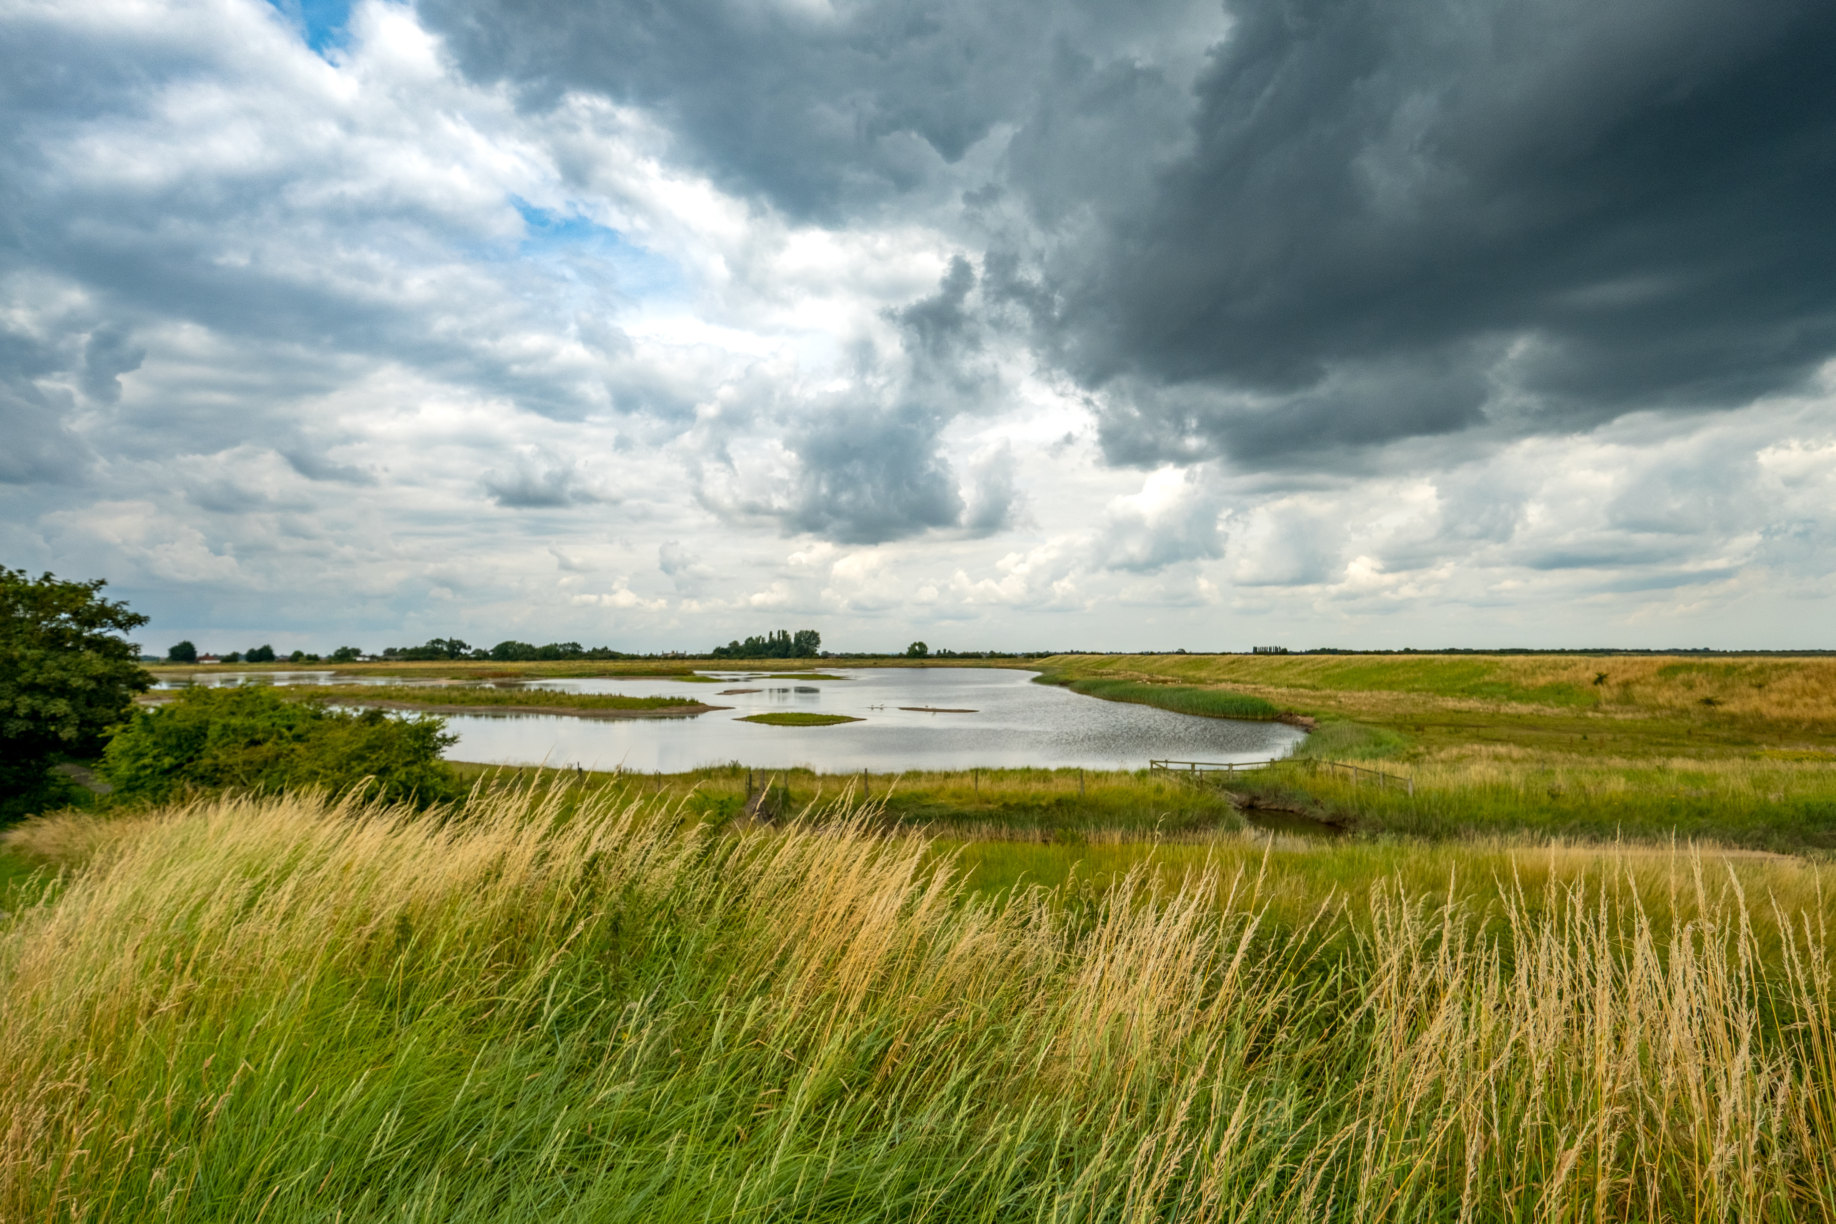
The modeling process and conceptual modeling

Slide 2
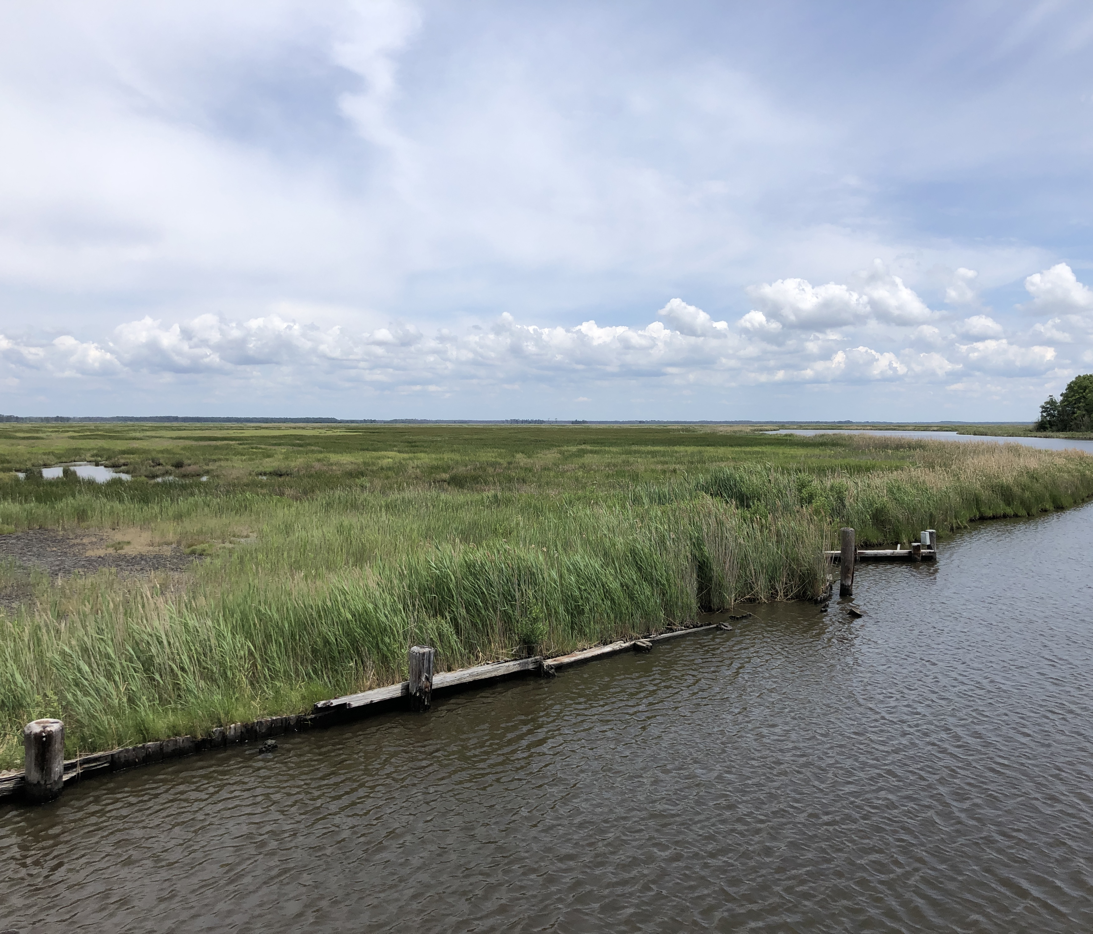
Overview
Describe the modeling process
What are conceptual models?
Development of conceptual models
Characteristics of useful conceptual models
Pitfalls and good practices
Documentation

Slide 3
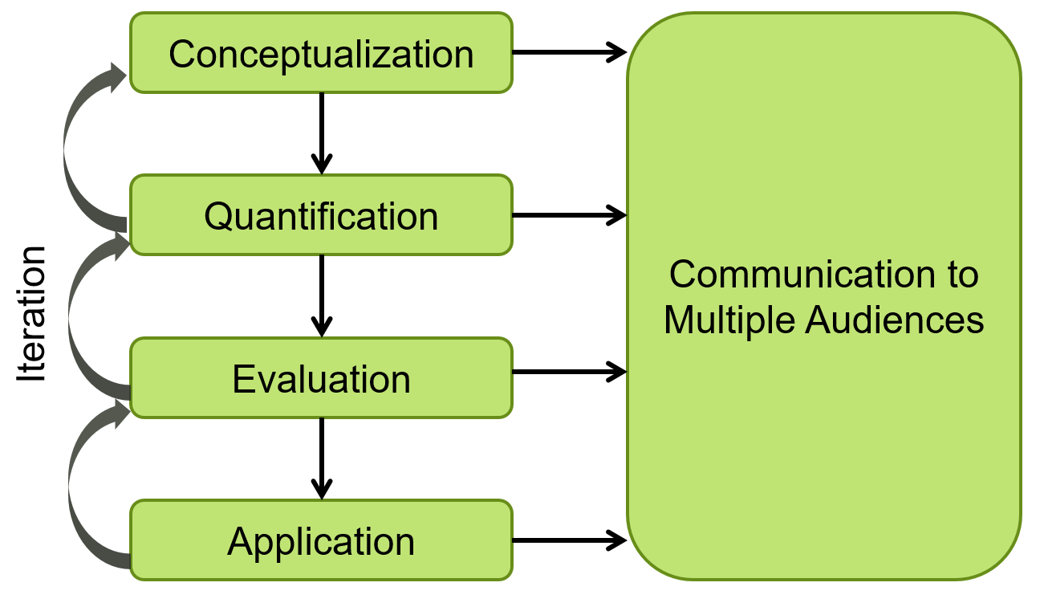
Modeling process
Iterate, iterate, sleep on it, iterate, talk about it, iterate

Slide 4
Different audiences need different models
General
Outreach tools to inspire broad audiences and build the coalition
Outreach tools for communicating policy-relevant “talking points”
Breadth
Outreach tools for specific groups design around a particular message or knowledge base (e.g., K-12 groups, artisans)
Numerical models for forecasting technical outcomes
Targeted
Non-Scientists
“Technical”
Scientists

Slide 5
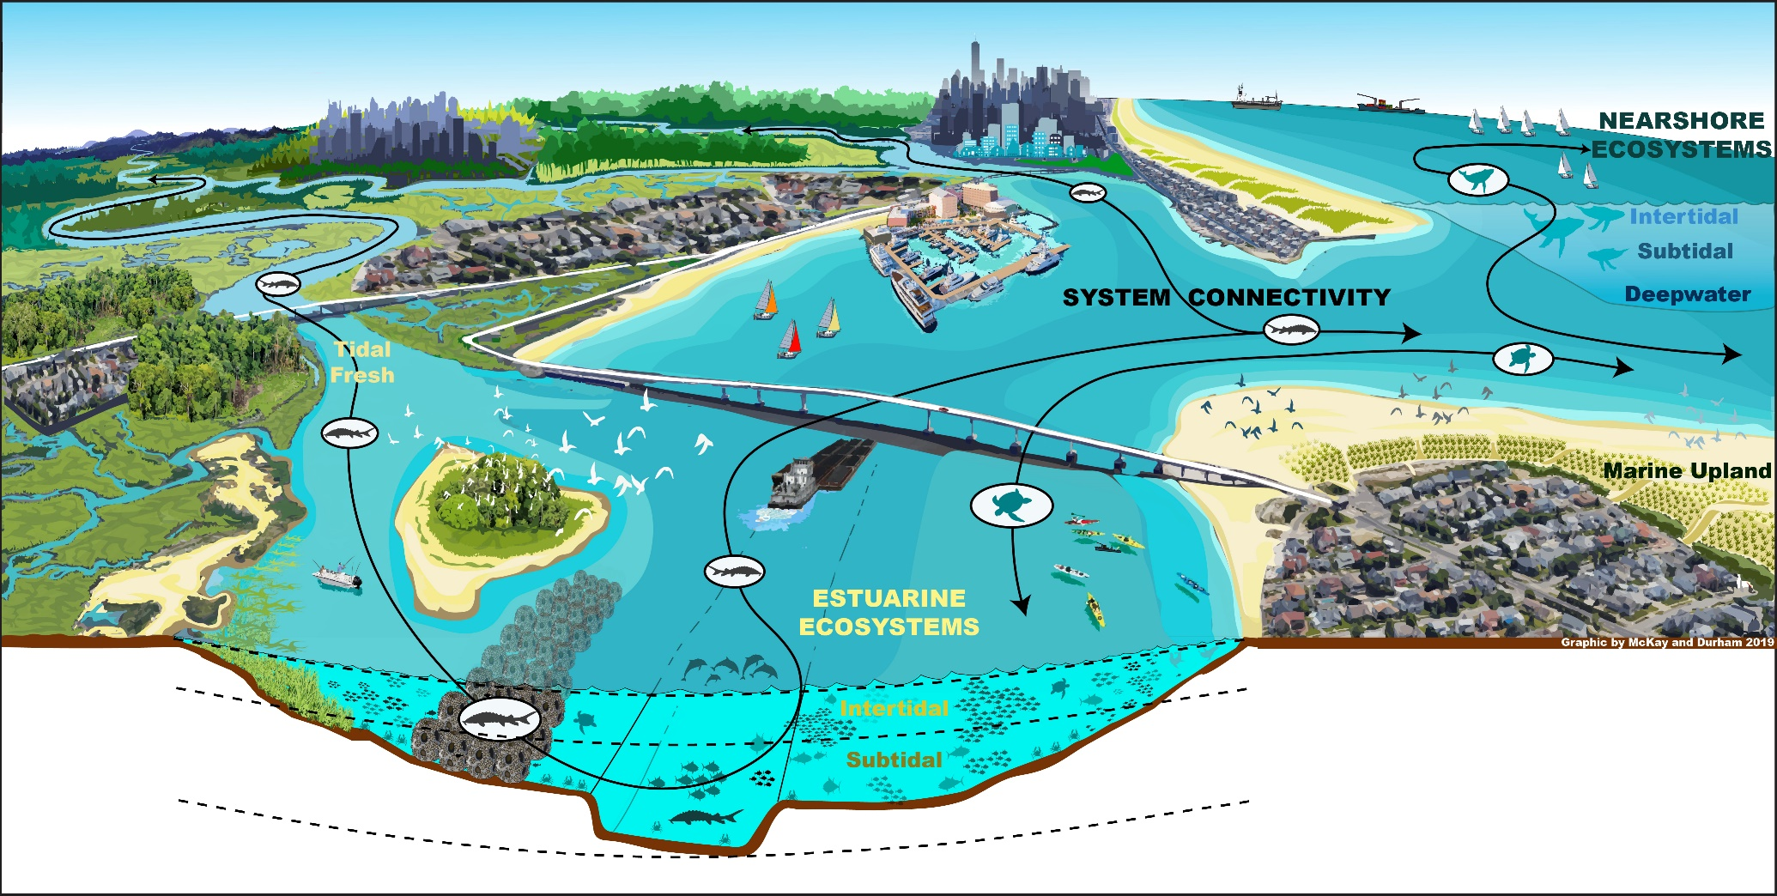
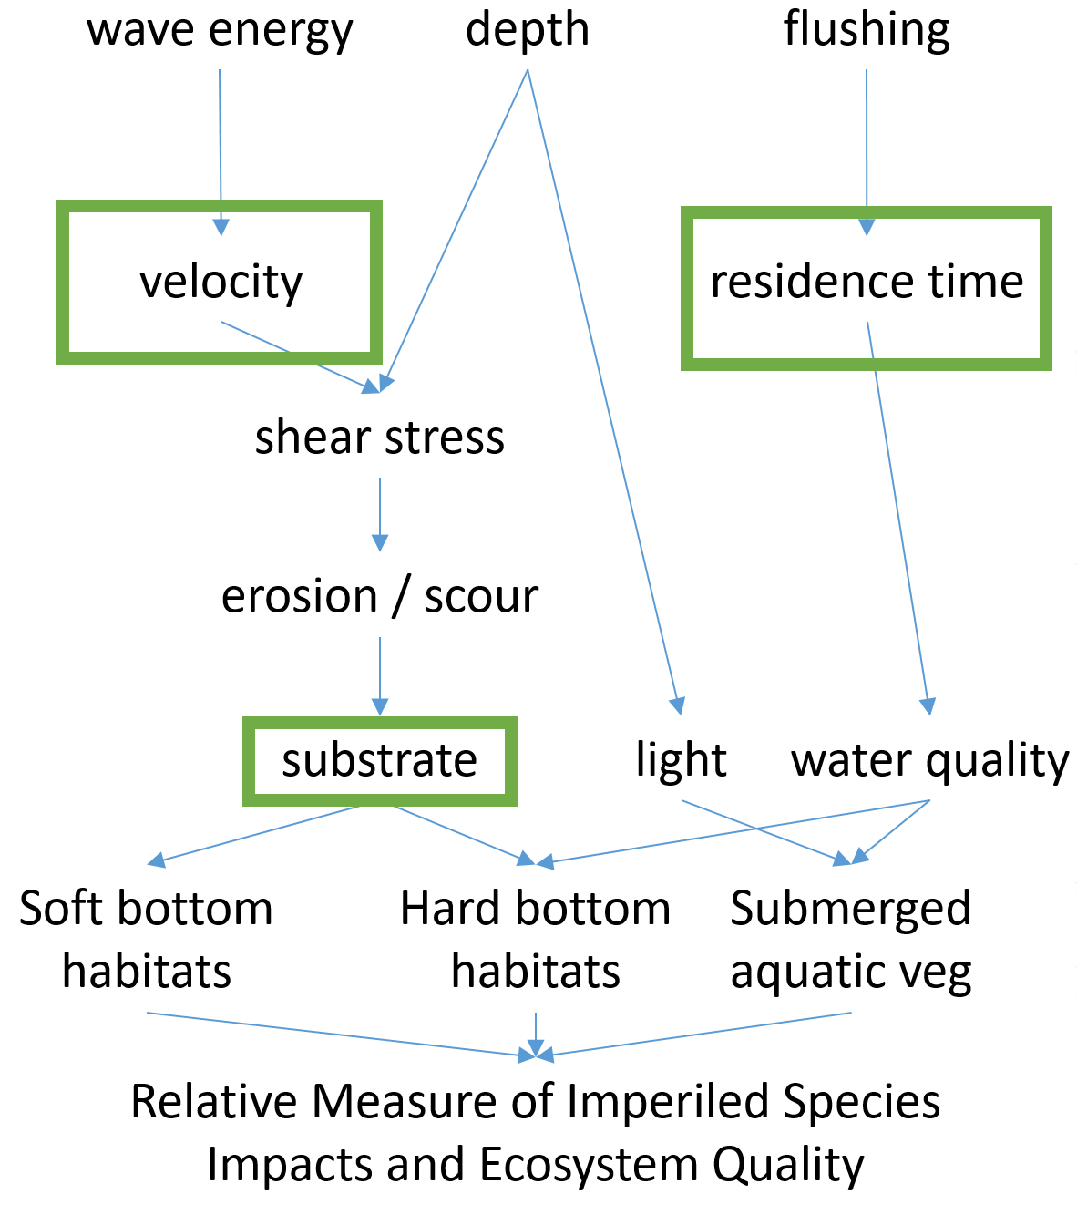
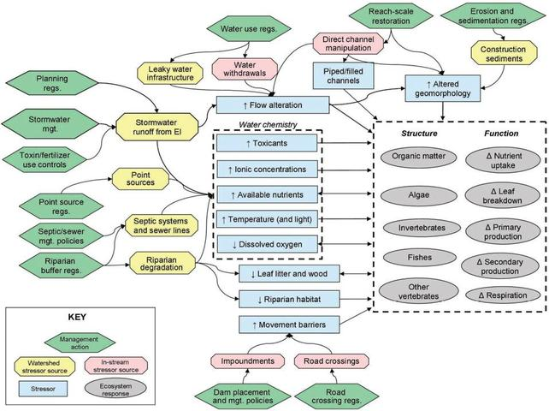
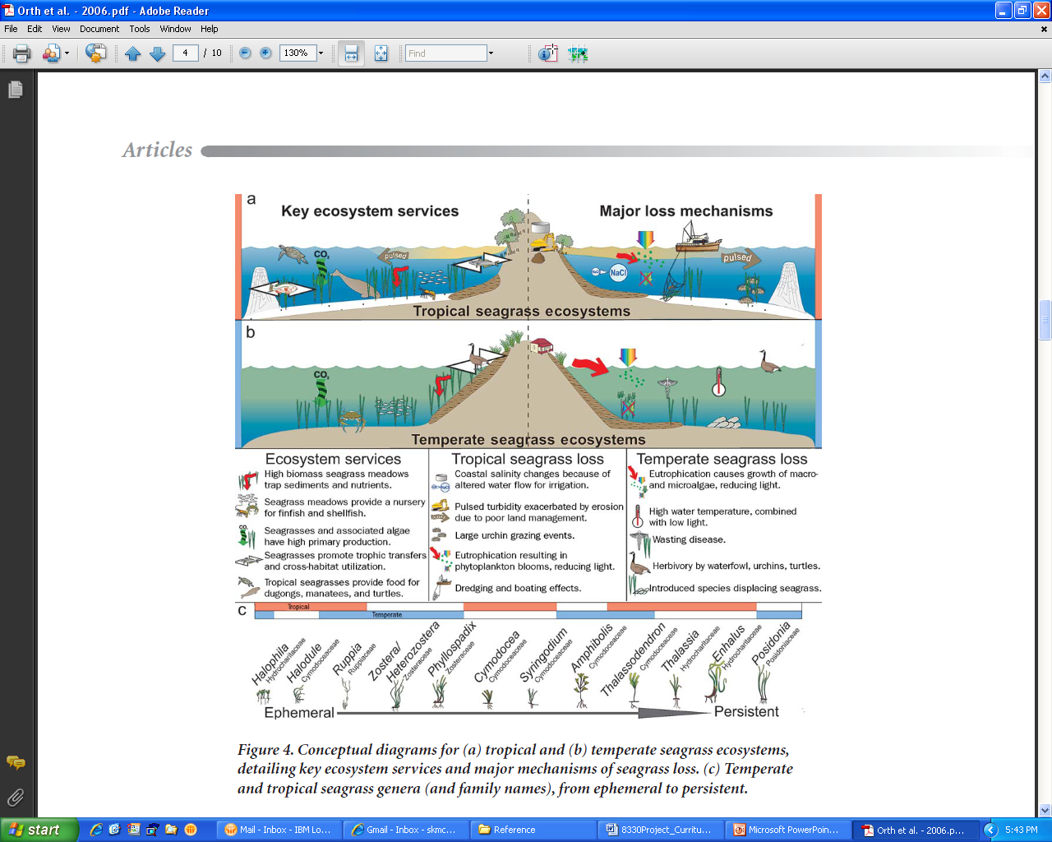
What are conceptual models?
Visual Storytelling
A conceptual model is a tentative description of a system or sub-system that serves as a basis for intellectual organization.
Describe functional relationships among essential system components
Tells the story of how the system works

Slide 6
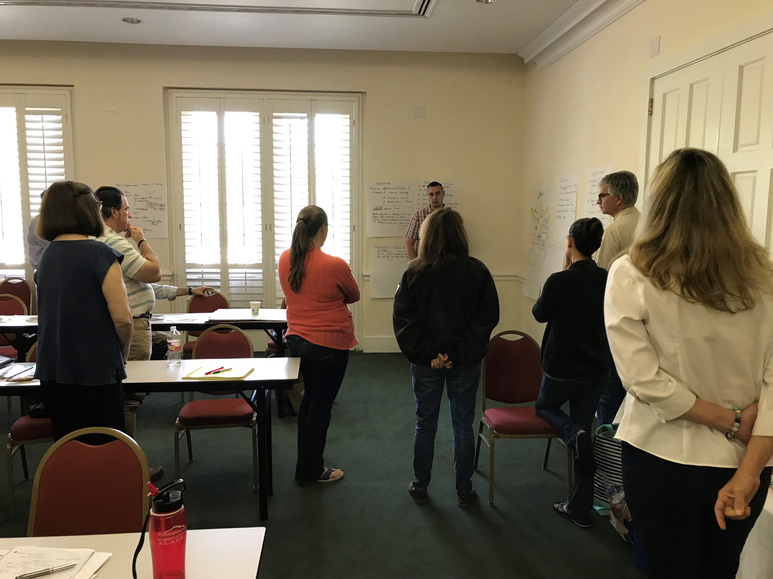
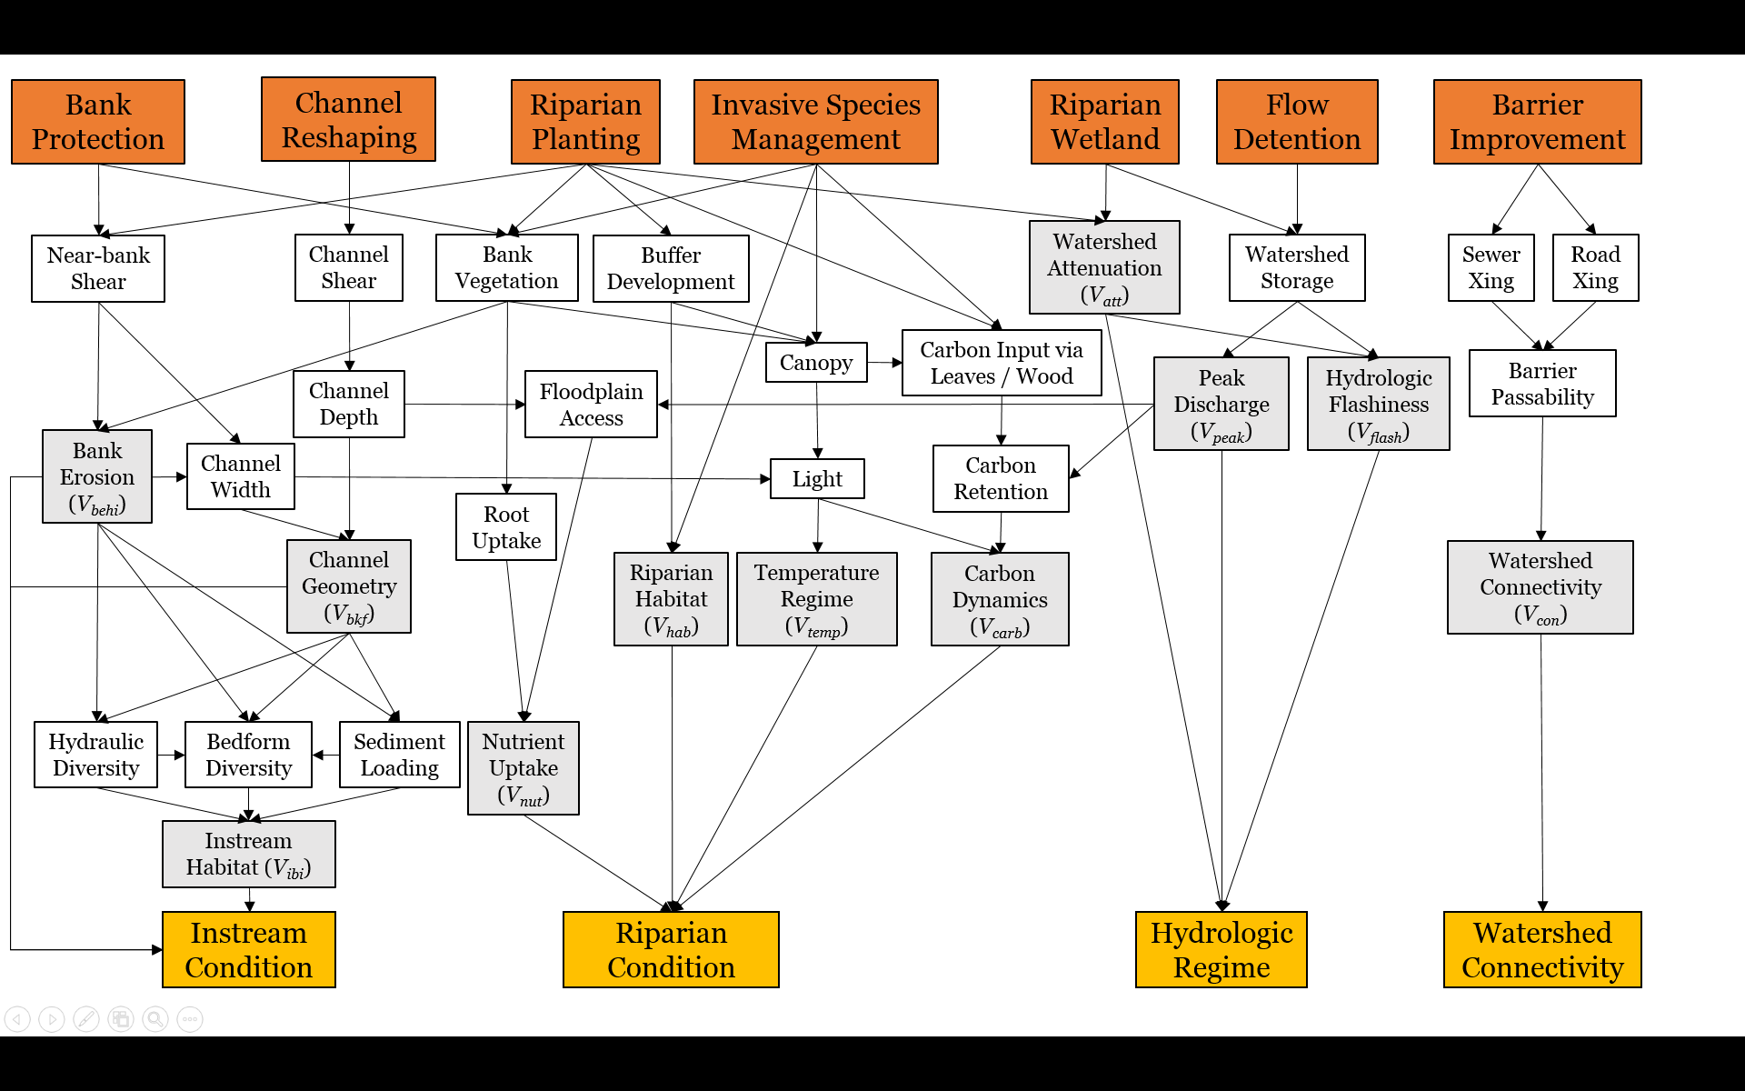
How are conceptual models used?
Develop a shared understanding:
Synthesis of different perspectives
Team building
Communication
Compilation of collective knowledge
Set the stage for numerical models:
Identify important variables
Describe critical processes
Articulate flow of logic
Define key data gaps
Inform restoration decisions:
Diagnose problems
Guide management actions
Identify key decision metrics
Inform monitoring plans

Slide 7
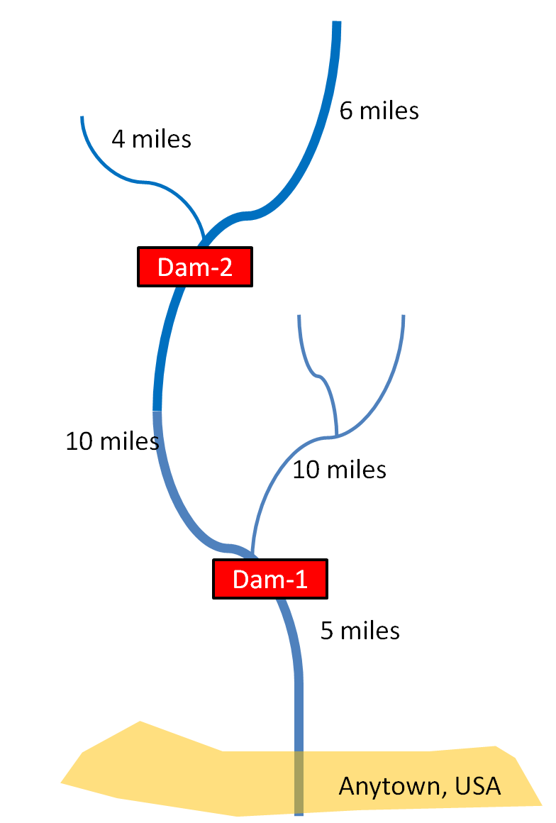
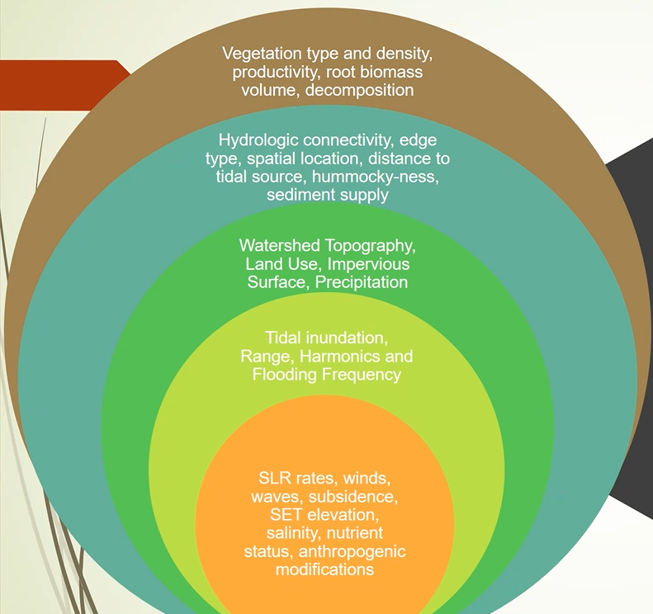
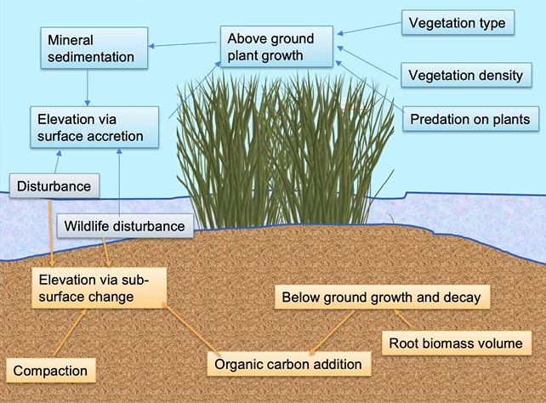
Different Types of Conceptual Models
Map (not always georeferenced)
Pictures & Diagrams
Box-and-Arrow Models

Slide 8
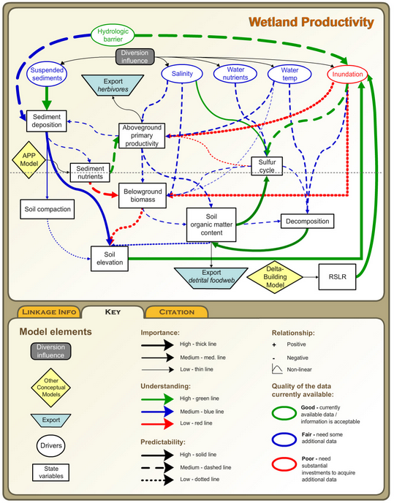
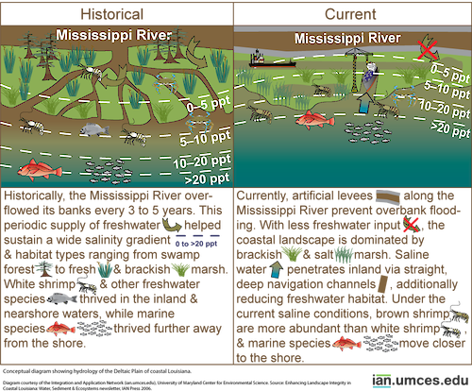
The same system can have many conceptual models
Figures: ian.umces.edu, Louisiana Coastwide Reference Monitoring System

Slide 9
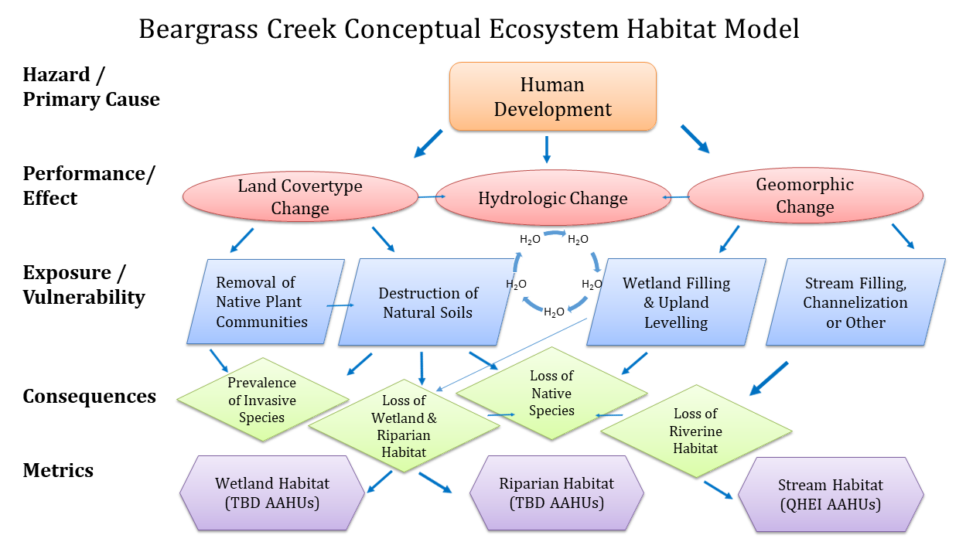
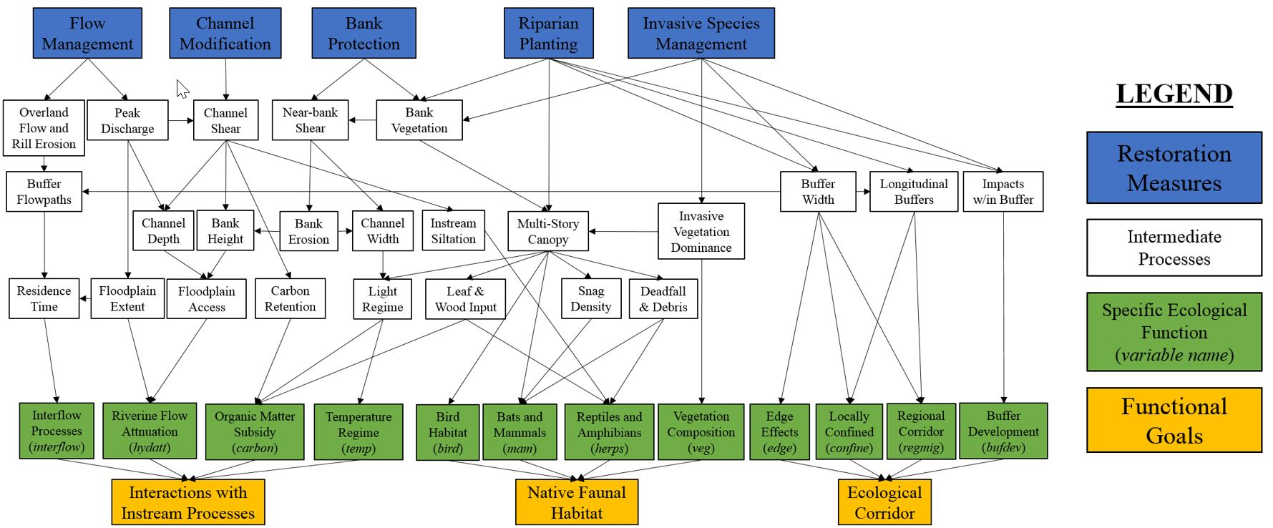
Conceptual models are NOT…
The truth – they are simplified depictions of reality
Comprehensive – they focus only upon parts of an ecosystem deemed relevant while ignoring other important (but not immediately germane) elements
Final – they provide a flexible framework that evolves as understanding of the ecosystem increases
Figures: USACE feasibility study on the Three Forks of Beargrass Creek, Louisville, Kentucky

Slide 10
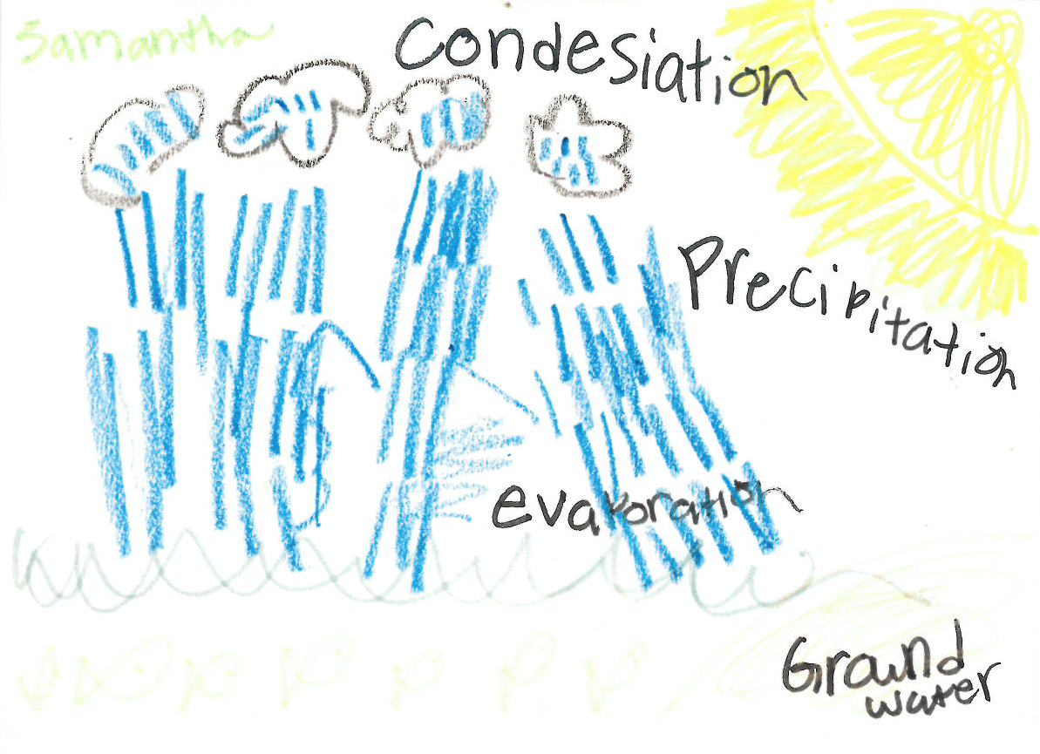
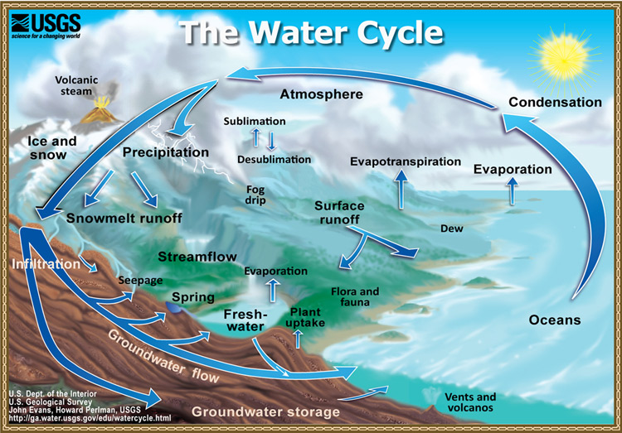
Common Misconceptions
A model cannot be built with incomplete understanding.
FALSE: Incomplete information is the norm in environmental management!
A model must be as detailed and realistic as possible.
FALSE: “Lean” models are often the most elegant. Remember Einstein’s aphorism…As simple as possible, but no simpler!
Figures: Sarah Miller’s niece, USGS

Slide 11
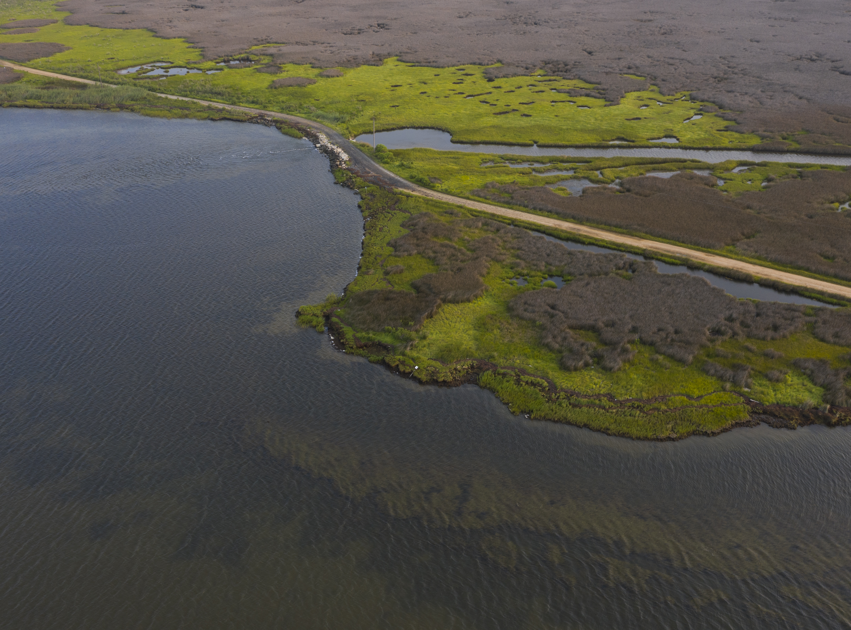
Conceptual Model Development

Slide 12
Conceptual Model Development
State the model objectives.
Bound the system of interest.
Identify critical model components within the system.
Articulate the relationships among the components.
Represent the conceptual model.
Describe the expected pattern of model behavior.
Test, review, and revise as needed.
Document each step!

Slide 13

Characteristics of useful conceptual models
Relevant to the problem
Directed at the appropriate spatial and temporal scales
Strike a balance between over-simplification and over-sophistication
Underpinned by scientific knowledge

Slide 14
Good conceptual ecological models should include:
Those physical, chemical and biological attributes of the system that drive dynamics.
The mechanisms by which ecosystem drivers, both internal (e.g., flow rates) and external (e.g., climate), cause change
Critical thresholds of processes and environmental conditions
Discussion of assumptions and gaps in the state of knowledge, especially those that limit the predictability of outcome
Identification of current characteristics of the system that may limit the achievement of management outcomes.
Adequate references to substantiate the model.

Slide 15
Reviewing conceptual models
Does it appropriately identify the assumptions, limitations, areas of disagreement, and gaps in the state of knowledge?
Will the model’s functionality shift through time (e.g., will processes change with land use or climate)?
Does it sufficiently account for long-term environmental variability and disturbance (e.g., drought, floods)?

Slide 16

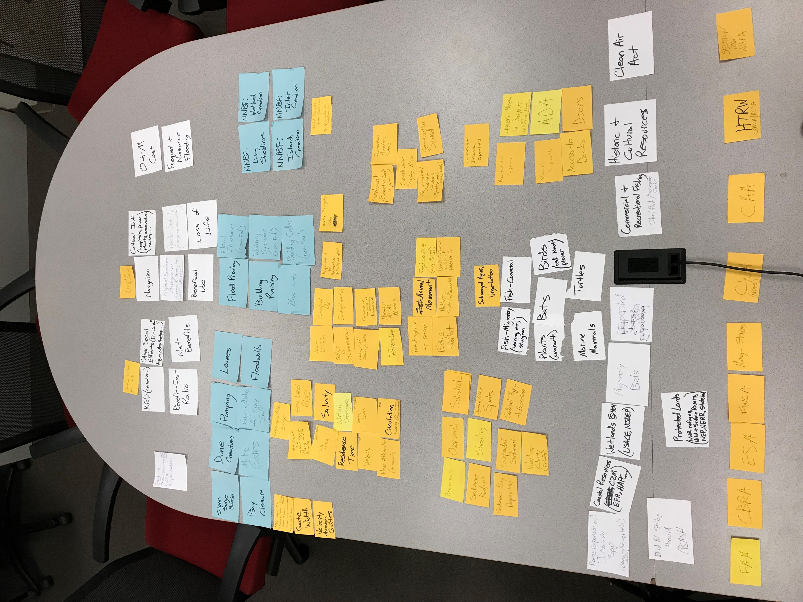
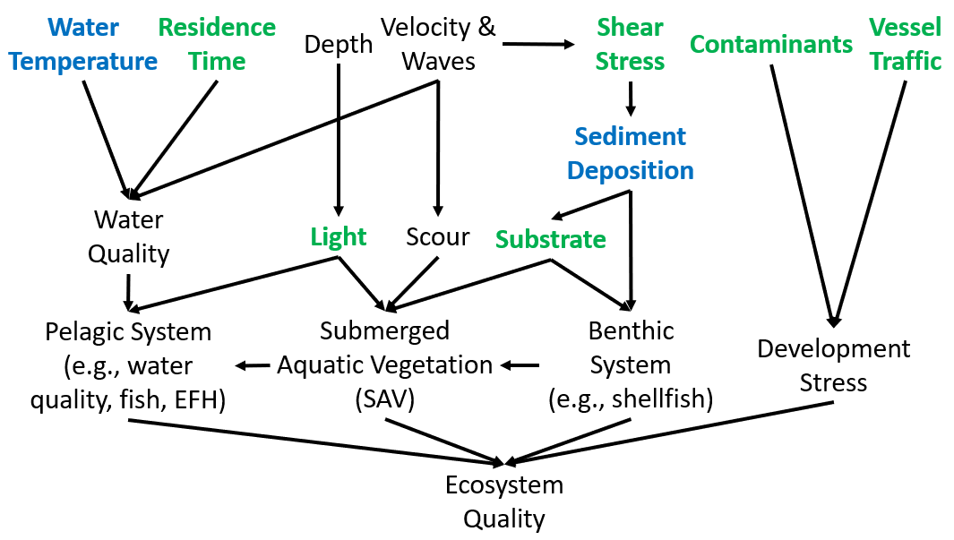
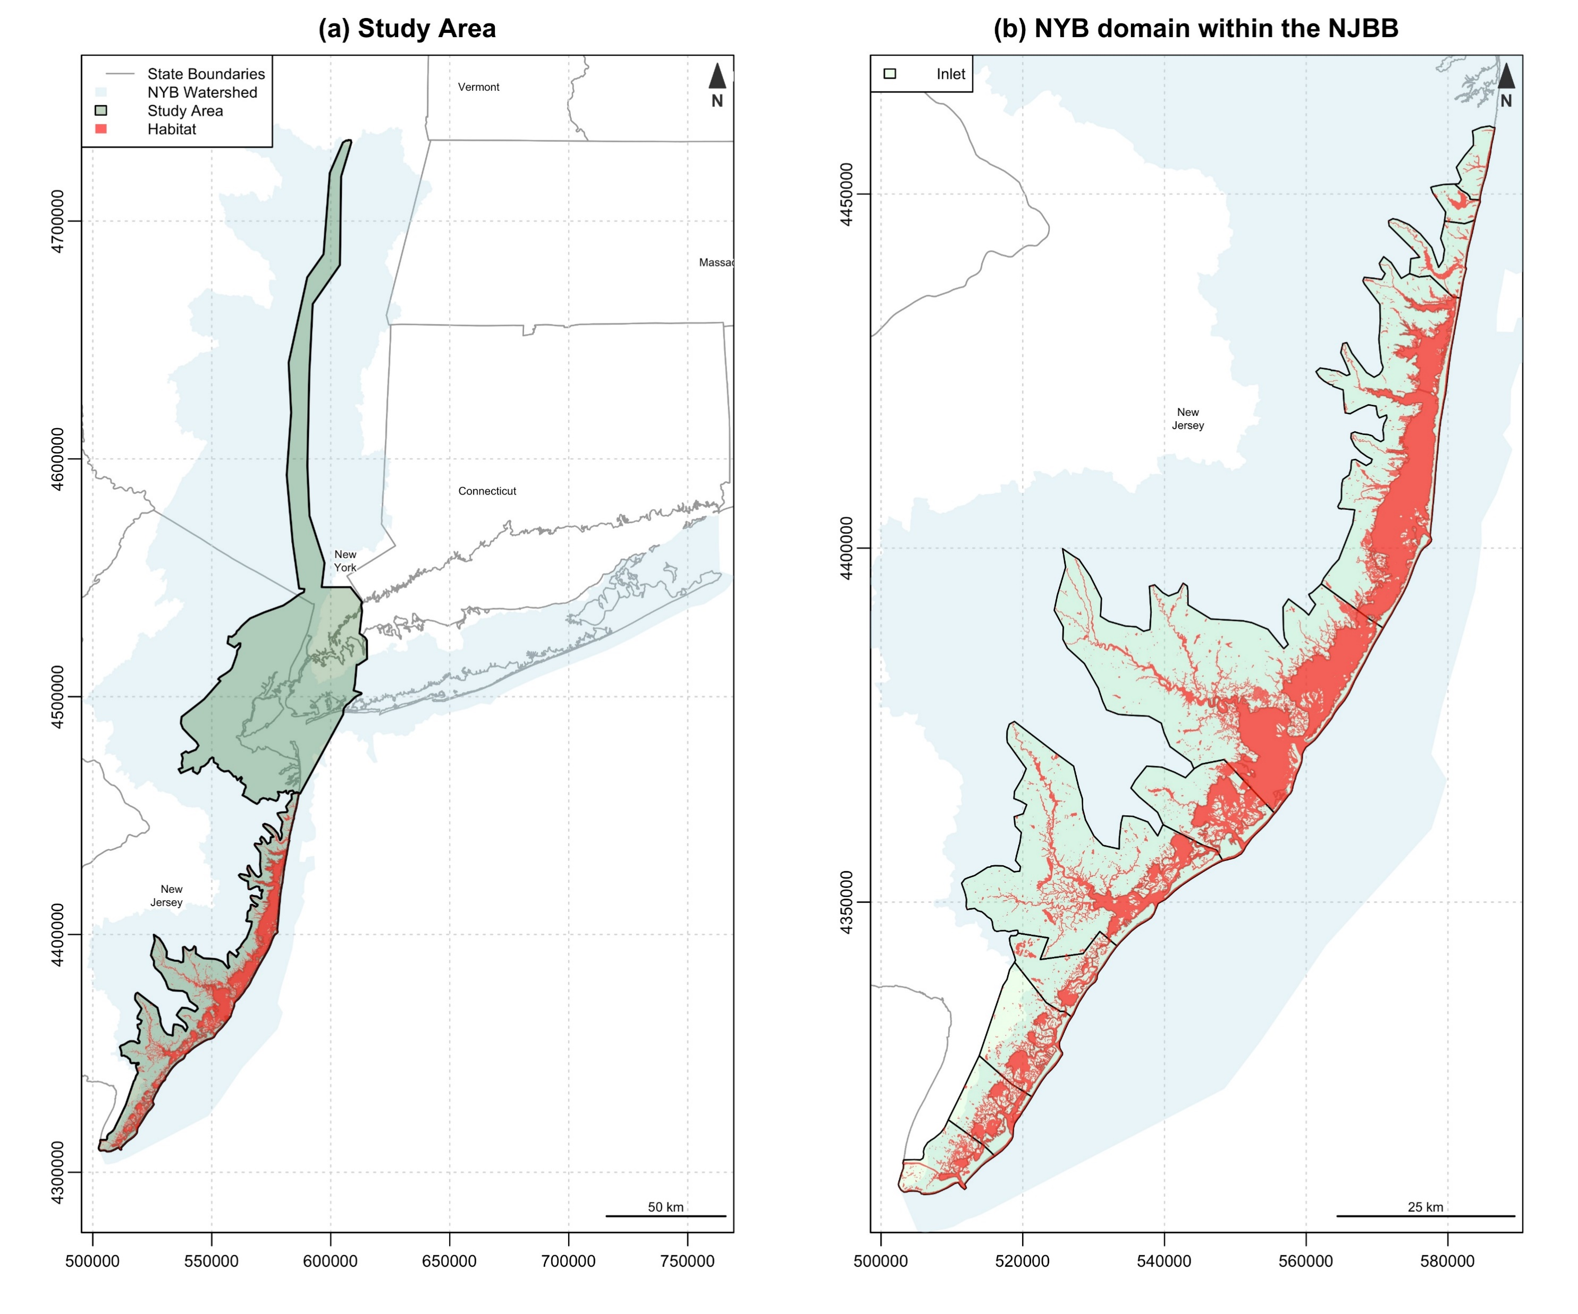
Think of conceptual modeling as storytelling
What audience are you reaching?
Who are the characters?
What is the plot?
What is the setting of your story?
Figures: New York Bight Ecological Model (McKay)

Slide 17
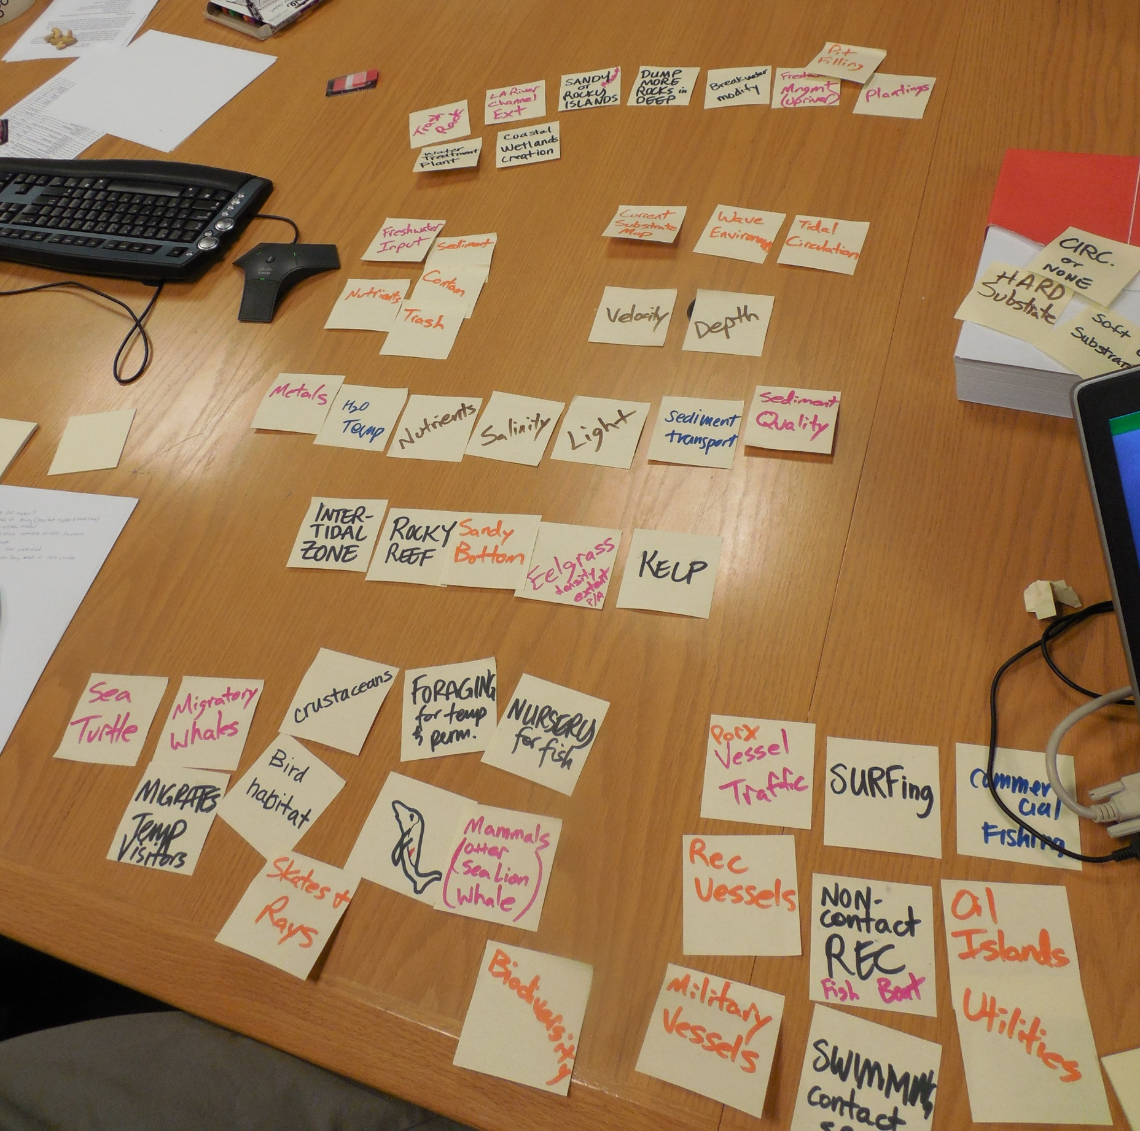
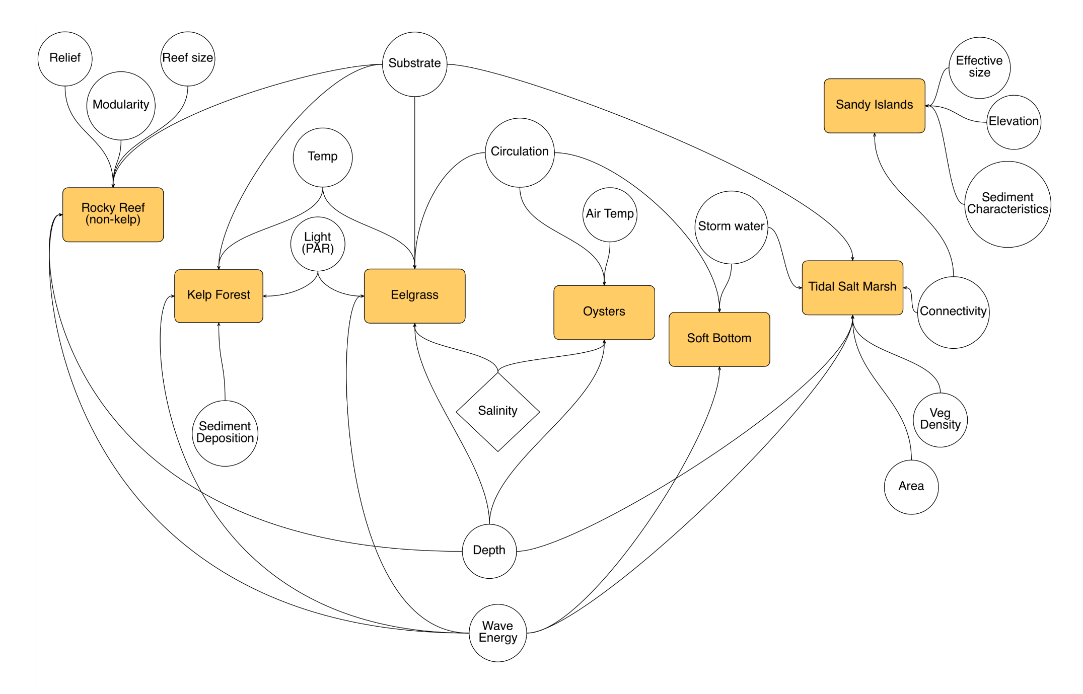
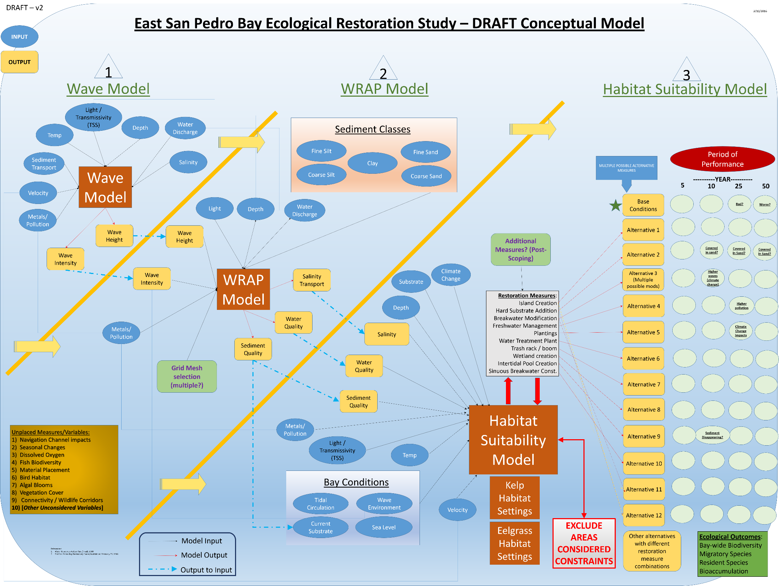
The “art” of conceptual modeling is in iterating

Slide 18
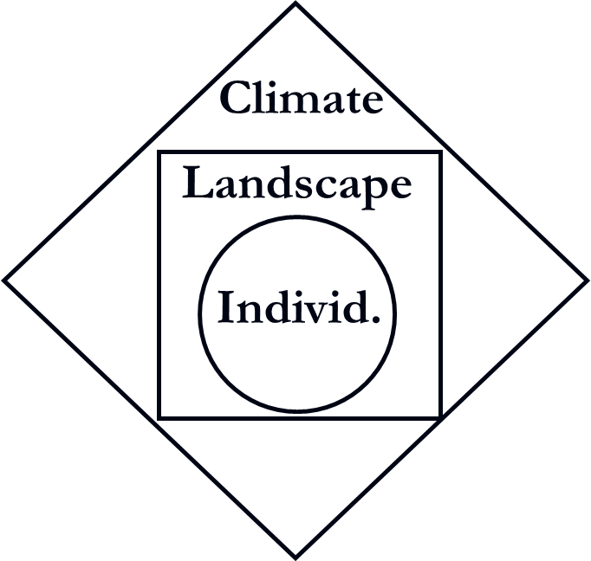
Conceptualizing agent-based systems
ABMs are difficult to conceptualize due to complexity.
Agentsets can have extensive “owned” characteristics
Multiple temporal and spatial scales are nested
Essentially a computer program
Multiple approaches for conceptualizing ABMs

Slide 19
Individual-based model Conceptual overview
Landscape/Animals
Population Dynamics
Dispersal
System
Level
Species
Natality
Water
Mortality
Individuals
Species
Life Stage
Location
Weight
Etc…
Individual
Level
Habitat Cells
Water
Hab. Quality
# of Ind.
Species present
Etc…

Slide 20
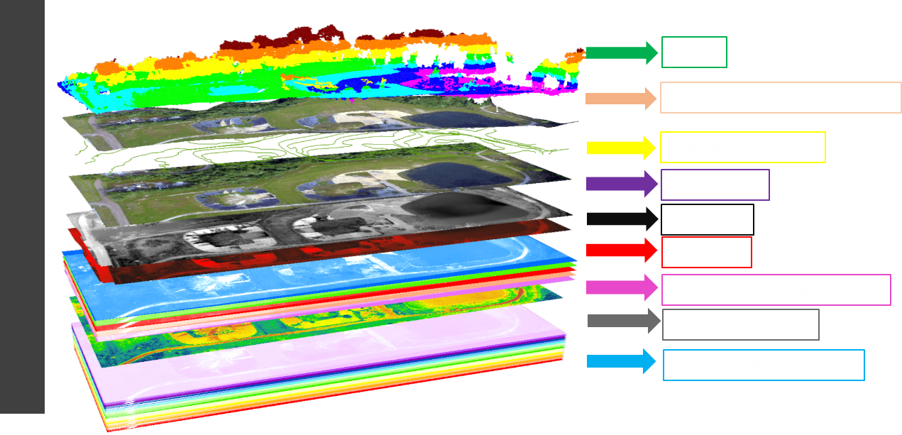
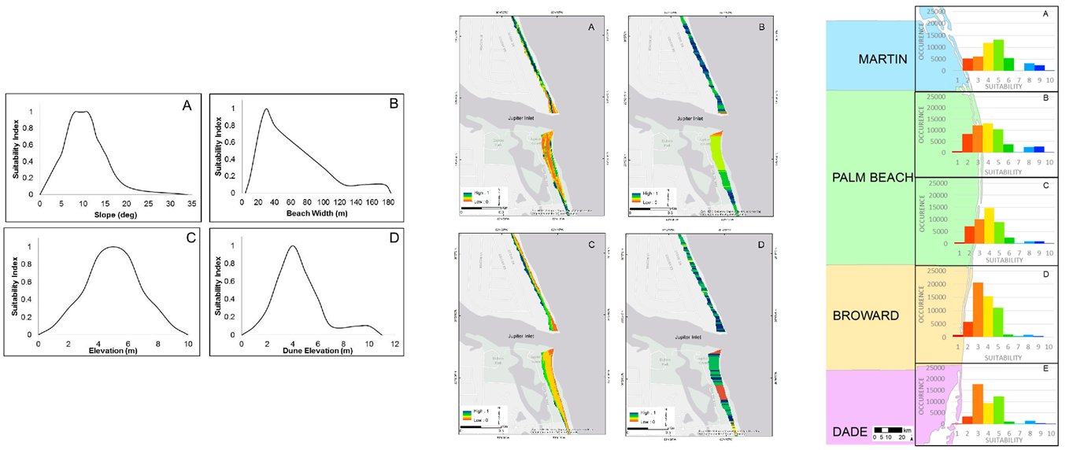
Spatial dimensions

Slide 21
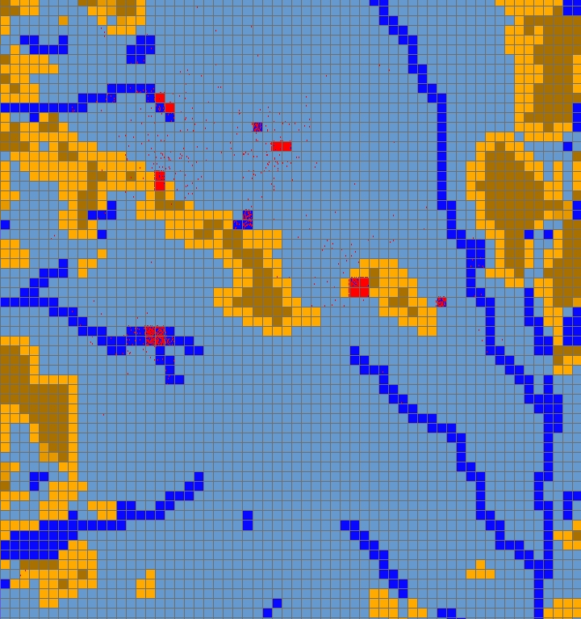
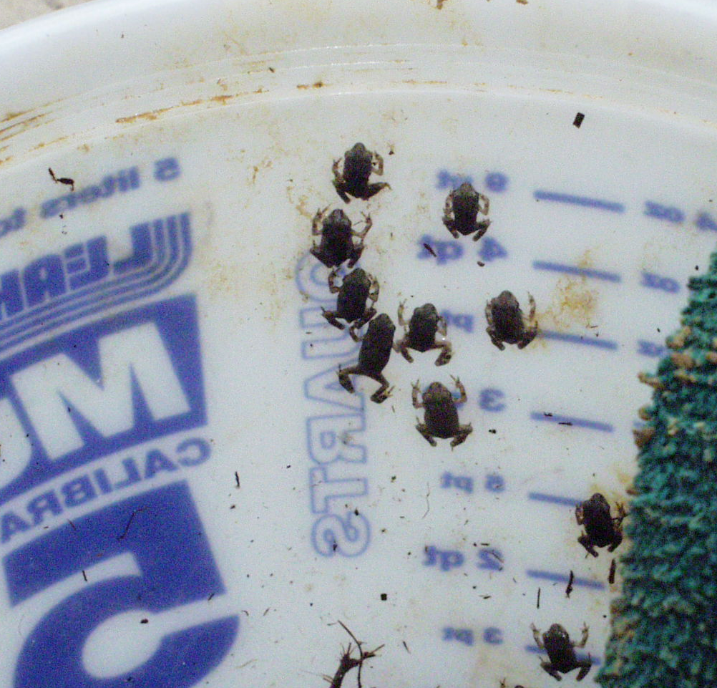
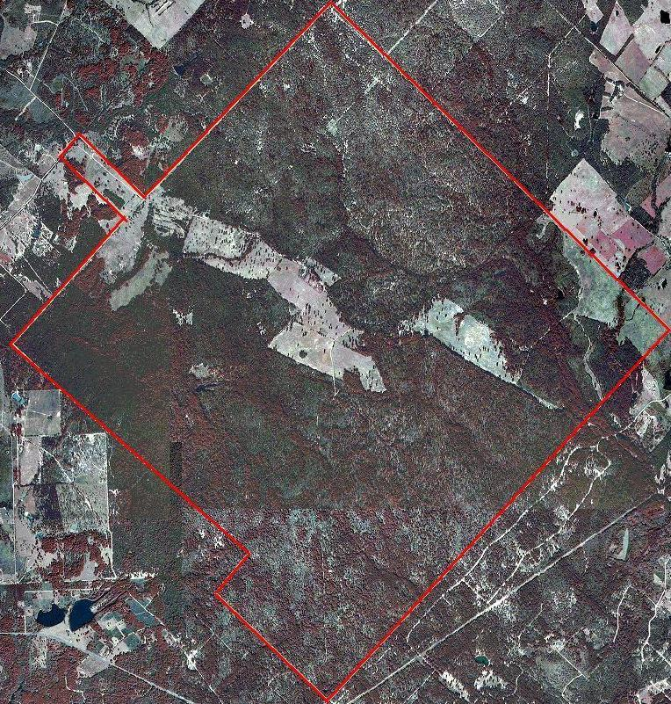
CX
100m x 100m
Individuals
Gender
Life Stage
Location
Etc…
+
Habitat Cells
Water
Hab. Quality
# of Ind.
Etc…
It’s tricky to conceptualize multiscale systems
Notes:
Trick is to get cell size and time step to be in-sync

Slide 22
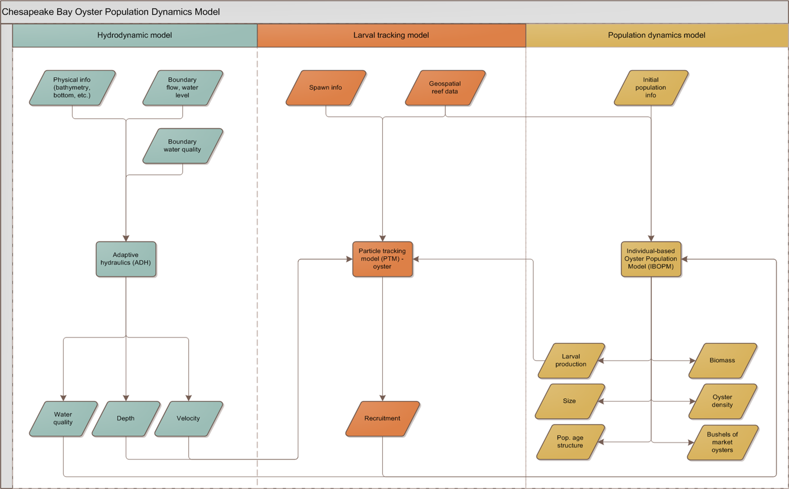

Slide 23
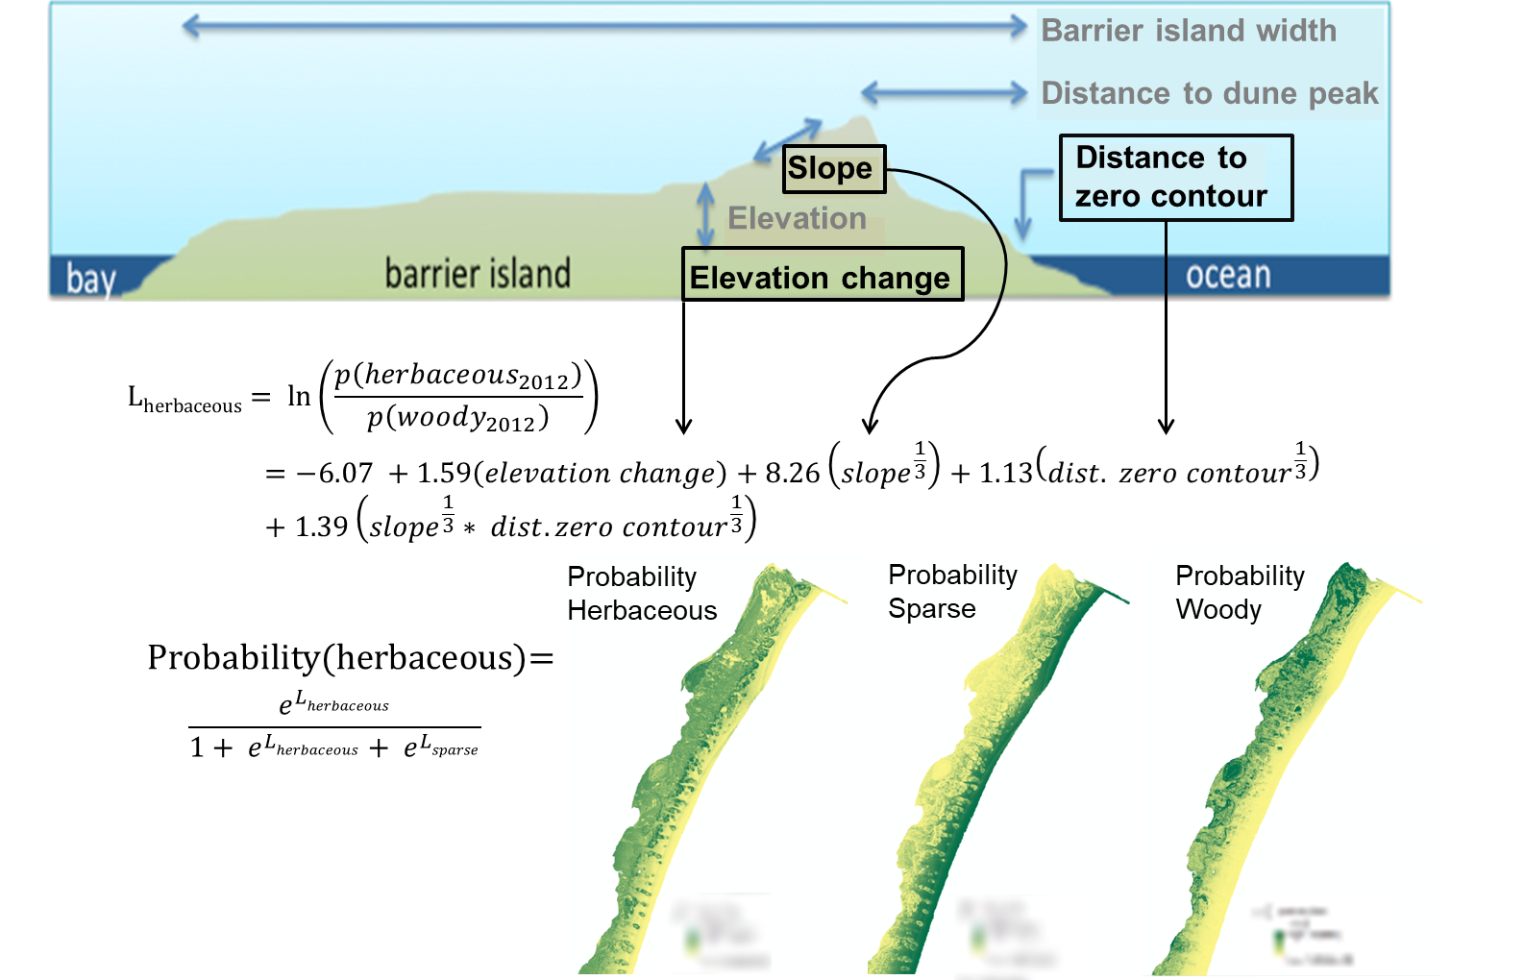
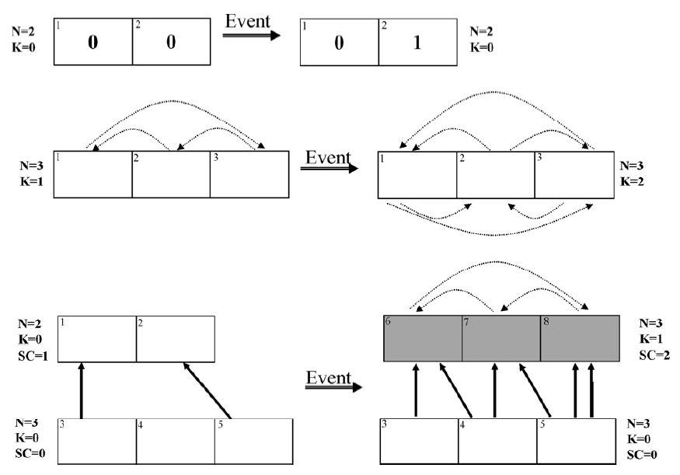
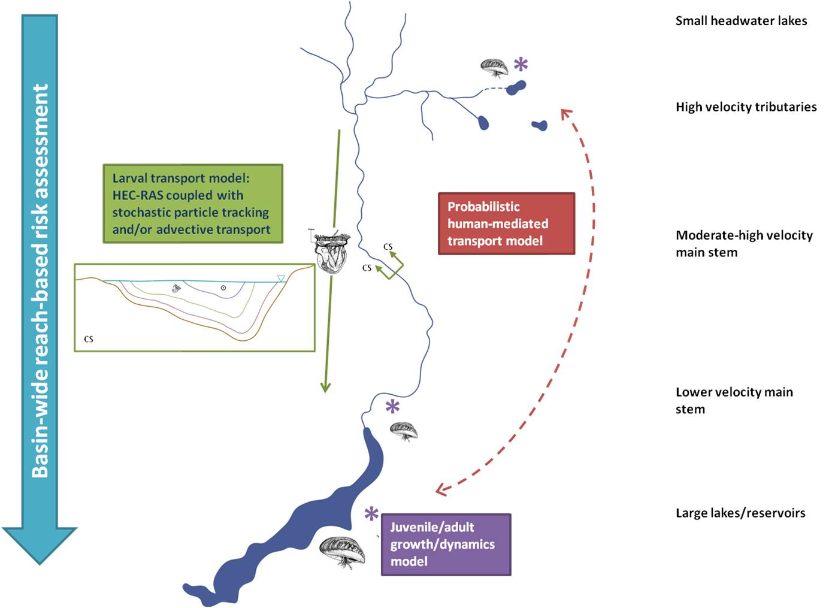
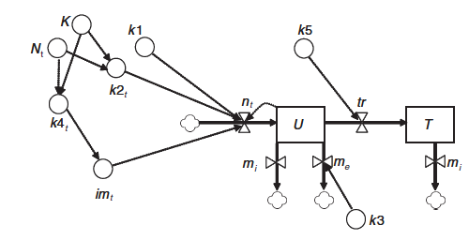
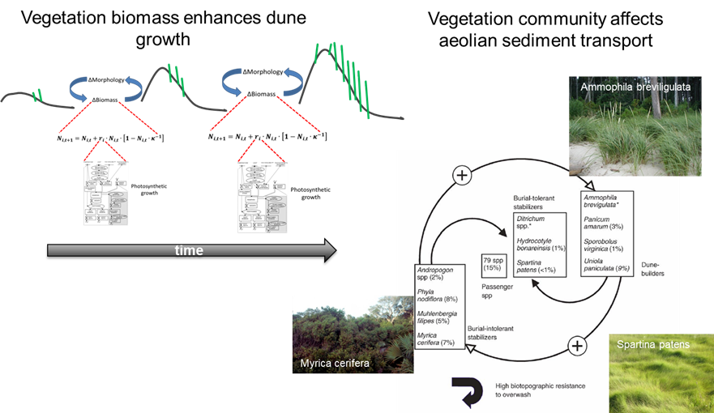
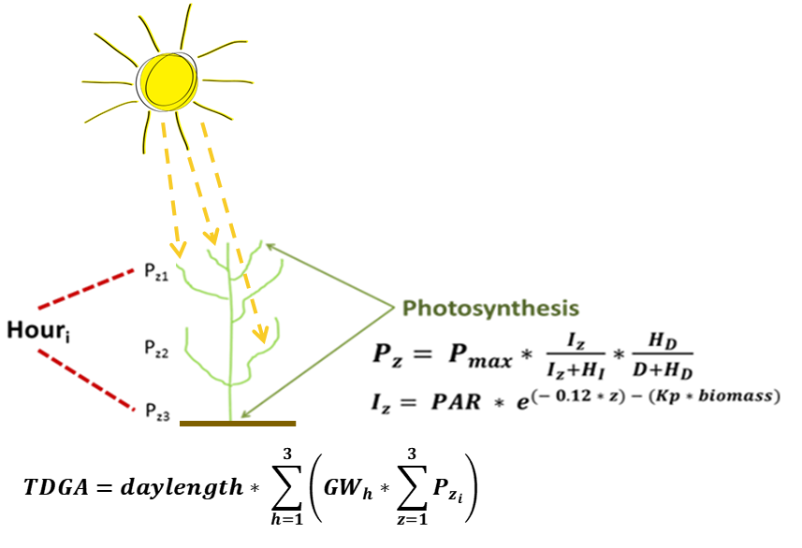

Slide 24
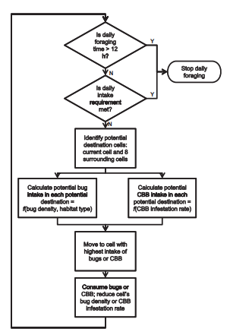
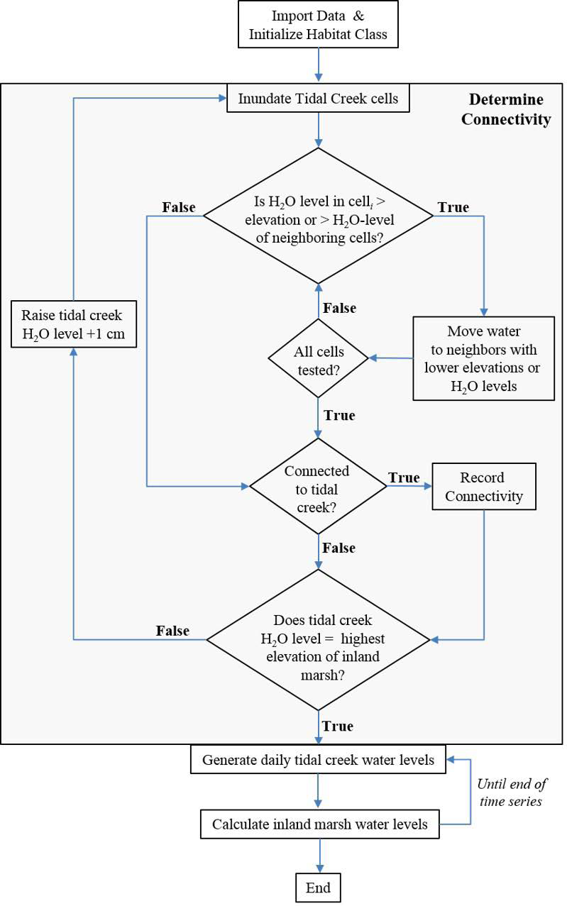
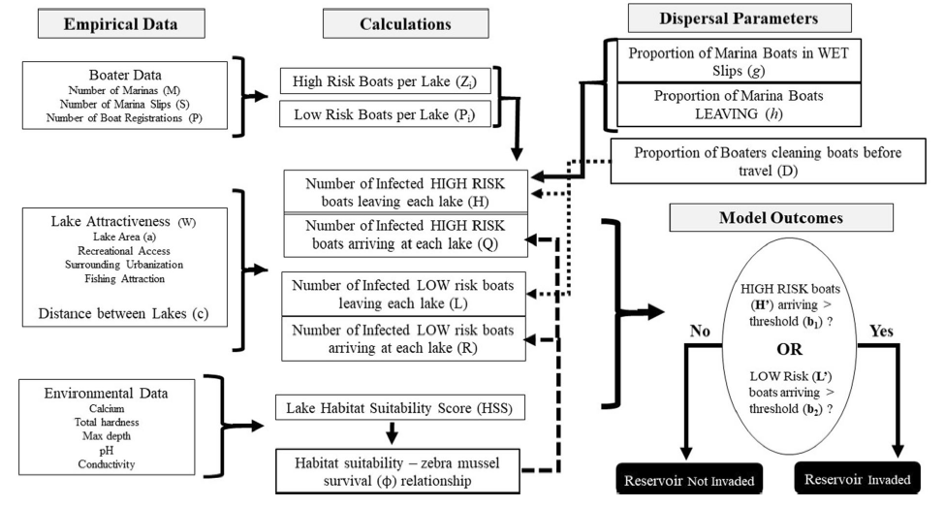
Coding diagrams

Slide 25
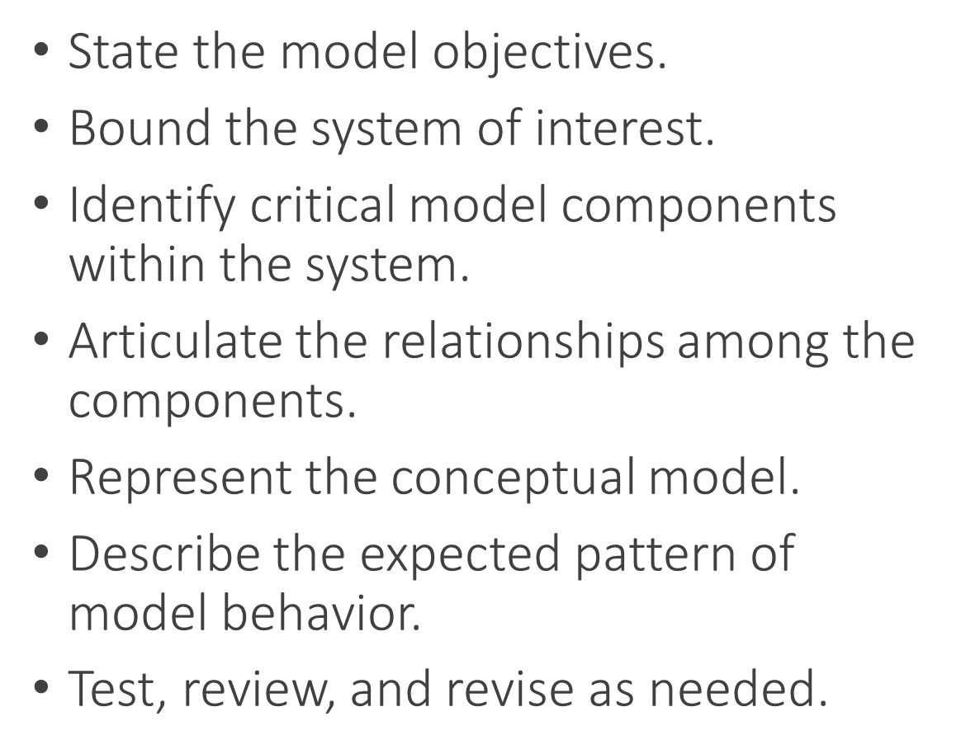
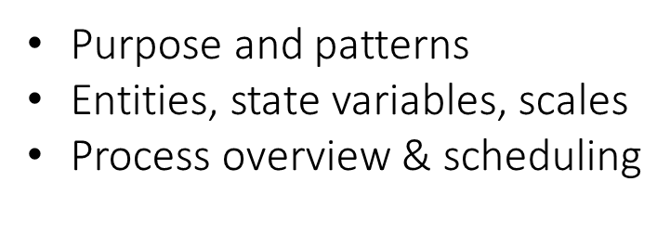
Documenting ABMs using ODD protocol (Chapter 3), part 1

Slide 26
Conceptual Modeling Exercise
Develop a conceptual model for your research question
Start big and write everything down.
Then group
Then connect
ID expected patterns with graphs (no specific numbers needed)
There are no “right” or “wrong” answers.
Your story is your story. There are no expectations about what will (or will not) emerge from these sessions.
Choose your own adventure.

Slide 27
Homework – Design your ABM
Using your conceptual models, start designing your ABM.
Answer the questions on page 42. No more than 2 pages.
Don’t worry about being super thorough, we’ll work through any trouble spots
Homework – Netlogo Dictionary

